Slide 1

Introduction to Machine Learning
Introduction to Python
By <Trainer’s Name>
<Date>

Slide 2
Introduction
<Topic>

Slide 3


Introduction
Python is a Object-oriented, interpreted, high-level programming language. It is general purpose and you use it to develop GUI and web applications.
You can concentrate on the business logic of your code rather than investing a lot of time in common programming tasks.

Slide 4

Introduction
Python was created by Guido Van Rossom
The initial code was published for the Version 0.9 in 1991 and it grew up to Version 1 in January 1994

Slide 5
Introduction
There are 1000’s of languages, so why Python?
01
Python is simple and easy to learn
02
It has a library for almost everything. Django for web development and matplotlib for data visualization
03
It is reliable, efficient and time saving
04
A large, active and a helping open source community
05
Career opportunities in various fields

Slide 6





Introduction
Where can you use Python?
Hardware Programming
05
Raspberry Pi
Machine Learning, DS, Deep Laearning
03
Sklearn, Tensorflow, Theano, Spark
04
Cloud and DevOps
OpenStack APIs, Fabric
Web Application
01
Django, Flask, Tornado
02
Desktop Application
PyGTK, Cocoa

Slide 7










Introduction
Top companies using Python

Slide 8
Introduction
Getting started: Installing Python
Ubuntu: sudo apt-get install python3.8
Fedora: sudo dnf install python3
CentOS: sudo yum install python3
Windows: Download from python.org/downloads/

Slide 9
Python Variables
<Topic>

Slide 10
Python Variables
A variable is a memory location where you can store values and in python the datatype will get chosen according to the data you provide
It should start with a letter or an underscore and cannot start with numbers. There are two ways of assigning values to a variable:
1
Assigning Value
2
Multiple Assignment

Slide 11
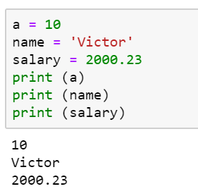

Python Variables
Assigning a single value to a variable
Assigning Value
Multiple Assignment

Slide 12
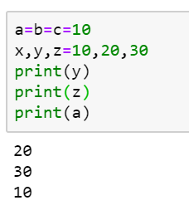
Python Variables
Assigning multiple values
Assigning Value
Multiple Assignment

Slide 13
Python Tokens
<Topic>

Slide 14
Python Tokens
In Python, every logical line of code is broken down into components known as Tokens.
The Normal Token types
Keywords
Identifiers
Literals
Operators

Slide 15
Python Tokens
What are Keywords?
01
Python Keywords are special reserved words
Keywords
Identifiers
02
Convey a special meaning to the compiler / interpreter
Literals
03
Each keyword have a special meaning and a specific operation
Operators
04
NEVER use it as a variable

Slide 16
Python Tokens
The Python keywords
Keywords
True | False | None | and | as
Asset | def | class | continue | break
else | finally | elif | del | except
global | for | if | from | import
raise | try | or | return | pass
nonlocal | in | not | is | lambda
Identifiers
Literals
Operators

Slide 17
Python Tokens
Identifiers are the name used to identify a variable, function, class or an object
Keywords
Rules for naming a identifier:
Identifiers
No special character except underscore ( _ ) can be used as an identifier
Keyword should not be used as an identifier name
Python is case sensitive, i.e Var and var are two different identifier
First character of an identifier can be character, underscore ( _ ) but not digit
Literals
Operators

Slide 18
Python Tokens
Literal is raw data given to a variable
Keywords
Various types of literals
Identifiers
String literals
Literals
Numeric literals
Operators
Boolean literals
Special literals

Slide 19
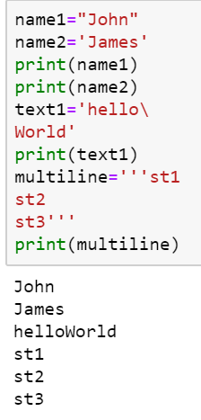
Python Tokens
What are String Literals?
Keywords
Formed by enclosing a text in the quotes. Both single and double quotes can be used
Identifiers
Input
Output
Literals
Operators

Slide 20
Python Tokens
What are Numeric Literals?
Keywords
It is a character string of digits from 0 to 9, decimal point, plus and the minus sign
Identifiers
Numeric literal formats
Literals
Int | Long | Float | Complex
+ve and –ve numbers(integers) with no fractional part. Ex: 100,-234 | Unlimited integer size followed by upper or lowercase L. Ex: 233424243L | Real numbers with both integer and fractional part Ex: -213.3 | In the form of a+bj. ‘a’ forms the real part & b forms the imaginary part. Ex: 3.14j
Operators

Slide 21
Python Tokens
Keywords
What are Numeric Literals?
Identifiers
In Python, value of an integer is not restricted by the number of bits and can expand to the limit of the available memory
No special arrangement is required for storing large numbers
Literals
Operators

Slide 22
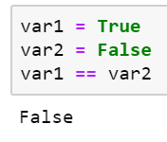
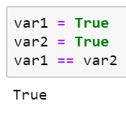
Python Tokens
What are Boolean Literals?
Keywords
It can either be True or False
Identifiers
Literals
Operators

Slide 23
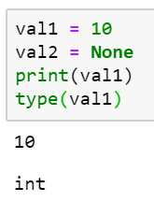
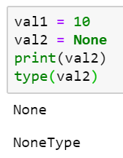
Python Tokens
What are Special Literals?
Keywords
There is a special literal in Python called None. Which means that variable is yet to be initialized.
Identifiers
Literals
Operators

Slide 24
Python Tokens
Operators are special symbols which are used to carry out arithmetic and logical operations
Keywords
Various types of literals
Identifiers
Arithmetic
Literals
Bitwise
Assignment
Identity
Comparison
Operators
Membership
Logical

Slide 25
Python Tokens
Arithmetic operators
Keywords
These are used for common mathematical operations
Identifiers
Operator | Operator Name
+ | Addition
- | Subtraction
* | Multiplication
/ | Division
% | Modulus
** | Exponentiation
Literals
Operators

Slide 26
Python Tokens
Assignment operators
Keywords
These are used to assign values to variables
Identifiers
Operator | Operation
= | X=10
+= | X=X+2
-= | X=X-29
*= | X=X*12
/= | X=X/3
|= | X=X|6
Literals
Operators

Slide 27
Python Tokens
Comparison operators
Keywords
Compares values and returns True or False
Identifiers
Operator | Operation
== | Equal
!= | Not equal
< | Less than
> | Greater than
>= | Greater than or equal to
<= | Less than or equal to
Literals
Operators

Slide 28
Python Tokens
Logical operators
Keywords
Used to combine conditional statements
Identifiers
Operator | Description
and | True is both statements are True
or | True if one of the statements is True
not | If True, then returns False
Literals
Operators

Slide 29
Python Tokens
Bitwise operators
Keywords
These are used to Compare binary numbers
Identifiers
Operator | Operation
& | AND
| | OR
^ | XOR
~ | NOT
<< | LEFT SHIFT
>> | RIGHT SHIFT
Literals
Operators

Slide 30
Python Tokens
Identity operators
Keywords
To compare objects if they are the same or not
Identifiers
Operator | Operation
Is | Returns True if both variables are same object
Is not | Returns True if both variables are not the same object
Literals
Operators

Slide 31
Python Tokens
Membership operators
Keywords
Used to test if a sequence is presented in an object
Identifiers
Operator | Operation
in | Returns True if the specified value is present in the object
not in | Returns True if the specified value is not present in the object
Literals
Operators

Slide 32
Data Types in Python
<Topic>

Slide 33
Data Types in Python
Data type
Immutable
Mutable
Strings
Dictionaries
Numbers
Tuples
Lists
Sets

Slide 34
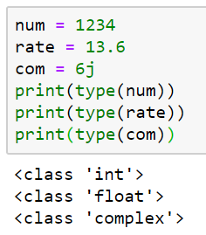
Data Types in Python
There are 3 numeric data types:
Numbers
Data Type | Description
Int | Integer type (Whole number, no decimels)
float | Floating point type (One or more decimels)
complex | Written with a imaginary number j
Strings
Tuples

Slide 35
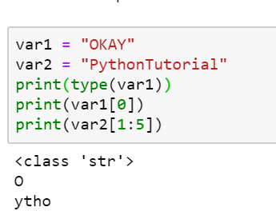
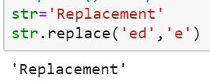
Data Types in Python
Strings
Numbers
The value of the string data type is a string literal
Strings
Tuples

Slide 36
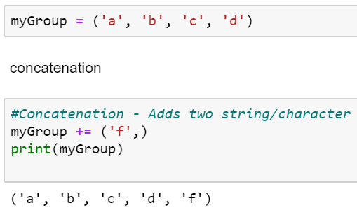
Data Types in Python
Tuples
Numbers
A sequence of immutable python objects
Strings
Tuples

Slide 37
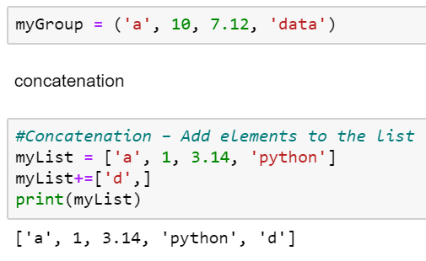
Data Types in Python
Lists
Lists
A sequence of mutable objects
Dictionaries
Sets

Slide 38
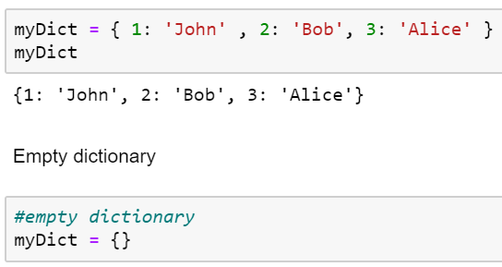
Data Types in Python
Dictionaries
Lists
It is an unordered collection of items
Dictionaries
Sets

Slide 39
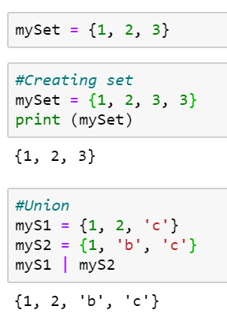
Data Types in Python
Sets
Lists
Unordered collection of immutable data and has no duplicate elements
Dictionaries
Sets

Slide 40
Conditional Statements
<Topic>

Slide 41

Conditional Statements
These statements are used to change the flow of execution when a provided condition is True or False`
You are sick
TRUE
FALSE
Go to the doctor
Go and play football

Slide 42
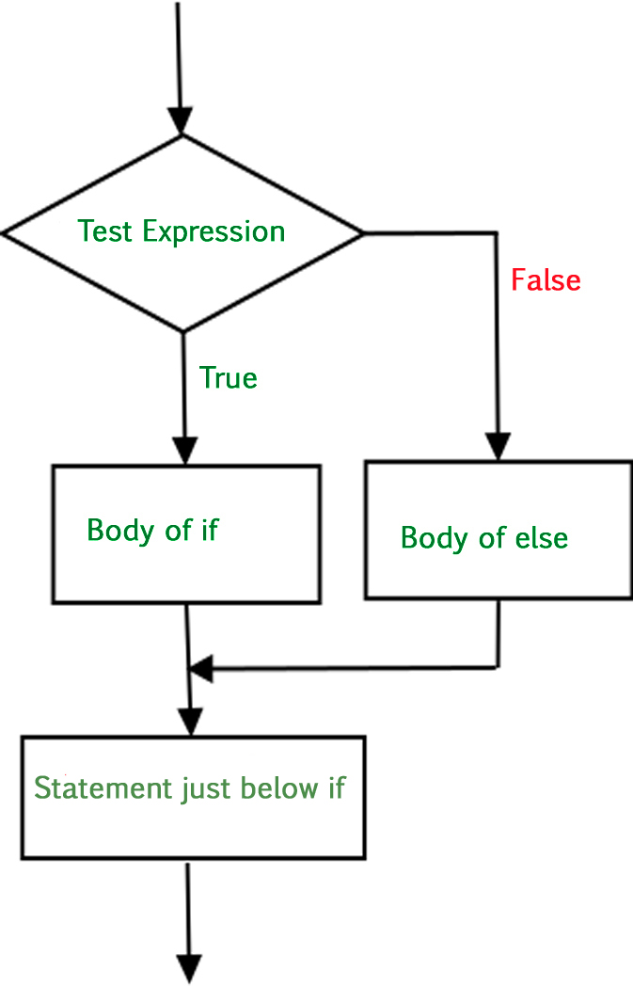
Conditional Statements
If-else
Nested if-else

Slide 43
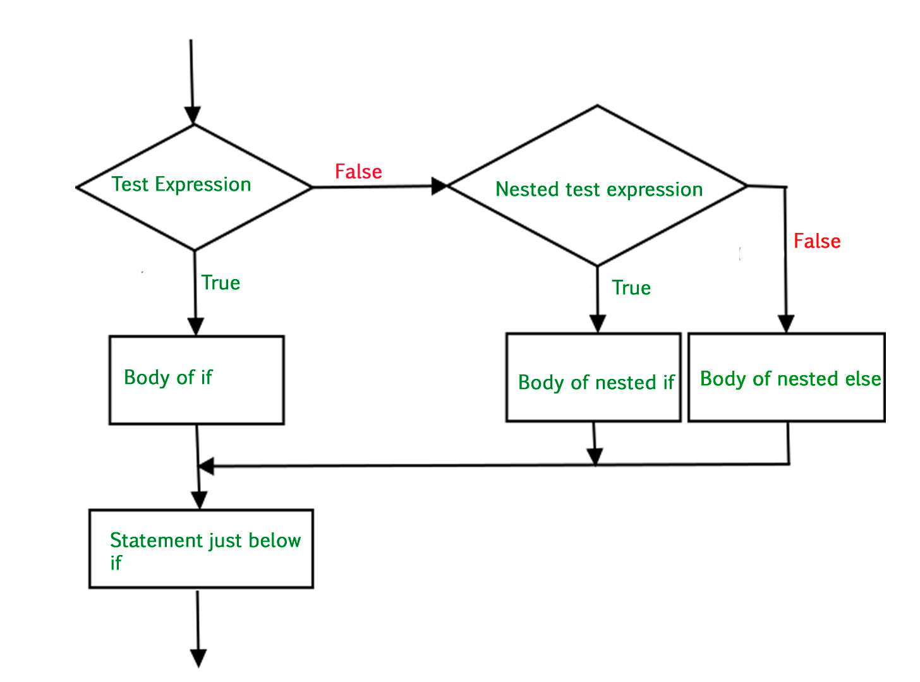
Conditional Statements
If-else
Nested if-else

Slide 44
Looping Statements
<Topic>

Slide 45
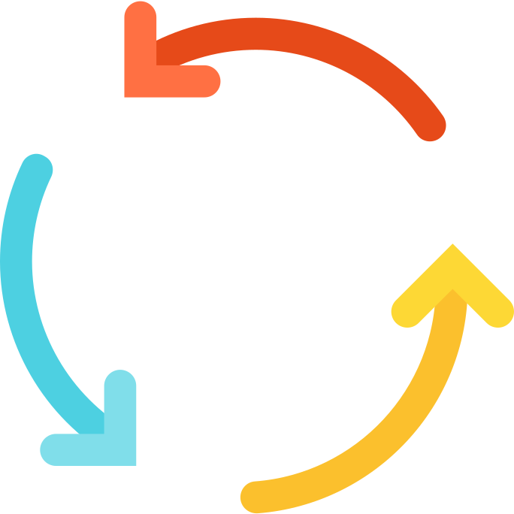
Looping Statements
Looping is the process in which you have a list of statements which executes repeatedly until it satisfies a condition

Slide 46
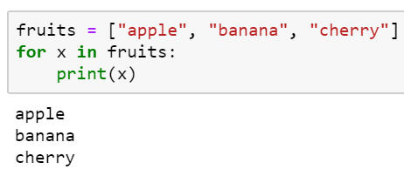
Looping Statements
Syntax
Flowchart
for
for iterate_var in list:
Statements
…
START
while
Count = 0
break
Execute Statements
Repeat
Add 1 to Count
continue
TRUE
Count < 10
FALSE
check if
Exit loop

Slide 47
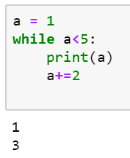
Looping Statements
Syntax
Flowchart
for
while(condition is True):
Statements
…
START
while
Count = 0
break
Execute Statements
Repeat
Add 1 to Count
continue
TRUE
Count < 10
FALSE
check if
Exit loop

Slide 48
Looping Statements
Syntax
Flowchart
for
while [ command ]
do
If [ command ]
then
break
fi
done
START
while
CHECK CONDITION 1
FALSE
Repeat
break
TRUE
Check break condition
TRUE
break
EXIT LOOP
continue
FALSE
EXECUTE BLOCK 1

Slide 49
Looping Statements
Syntax
Flowchart
for
while [ command ]
do
If [ command ]
then
continue
fi
done
START
while
CHECK CONDITION 1
FALSE
break
Repeat
TRUE
Check continue condition
TRUE
Continue
EXIT LOOP
continue
FALSE
EXECUTE BLOCK 1

Slide 50
Functions in Python
<Topic>

Slide 51
Functions in Python
A function is a block of organized, reusable sets of instructions that is used to perform some related actions
Functions
User-Defined Function
Built-in Function

Slide 52
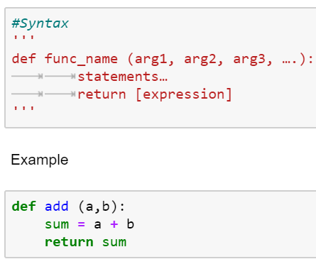
Functions in Python
These functions are created by the user
User-Defined Function
Built-in Function

Slide 53
Functions in Python
A function which is already available in a language which you can directly use in your code
abs(): Returns the absolute value of a number
all(): Returns True if all items in an iterable object are true
any(): Returns True if any item in an iterable object is true
ascii(): Returns a readable version of an object. Replaces non-ascii characters with escape character
bin(): Returns the binary version of a number
bool(): Returns the Boolean value of the specified object
User-Defined Function
Built-in Function

Slide 54
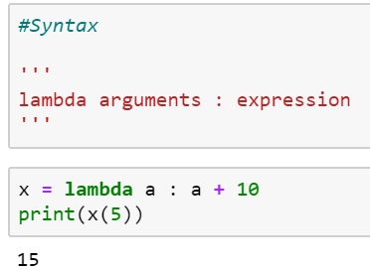
Functions in Python
Lambda Function
Anonymous function, i.e. a function having no name. Lambda function cannot contain more than one expression

Slide 55
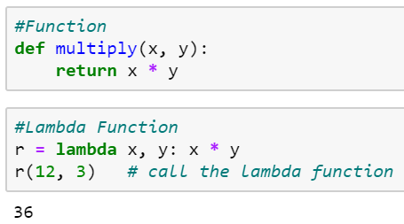
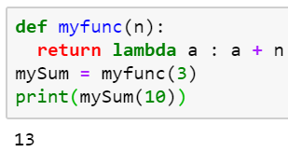
Functions in Python
Function vs Lambda Function
Power of Lambda: Anonymous Function inside another function…

Slide 56
Python Arrays
<Topic>

Slide 57
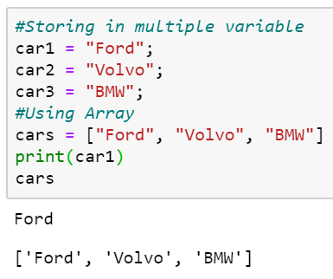
Python Arrays
Used to store multiple values in one single variable.
Python does not have built-in support for Arrays, but Python lists can be used instead

Slide 58
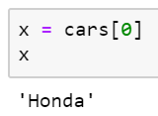
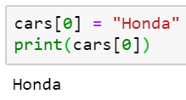
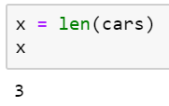
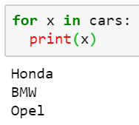
Python Arrays
01
02
Accessing an element
Modifying an element
03
04
Length of the array
Looping the array

Slide 59
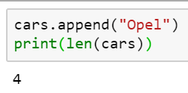
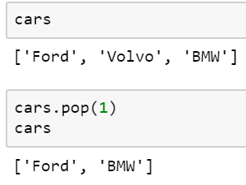
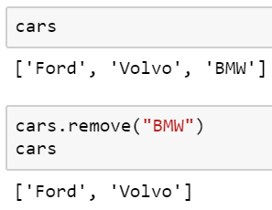
Python Arrays
05
06
Removing element in a position
Adding an element
07
Remove a specific element

Slide 60
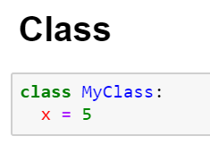
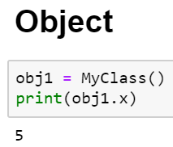
Python- Classes and Objects
What is a class and an object in Python?
Python is an object-oriented programming language
Almost everything in Python is an object, with its properties and methods
A Class is like a "blueprint" for creating objects

Slide 61
File Handling in Python
<Topic>

Slide 62

File Handling in Python
Why do we need file handling?
File handling is important in any application which handles permanent data. We will need file handling if we had to read in to or write from files

Slide 63
File Handling in Python
The important file handling operations
Open
Read
Write / Create
Delete

Slide 64
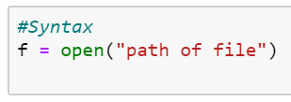
File Handling in Python
File Handling in Python
The open() function takes two parameters: filename and mode.
Open
Read
Mode options
Write / Create
"r" - Read - Default value. Opens a file for reading, error if the file does not exist
"a" - Append - Opens a file for appending, creates the file if it does not exist
"w" - Write - Opens a file for writing, creates the file if it does not exist
"x" - Create - Creates the specified file, returns an error if the file with same name exists
Delete

Slide 65
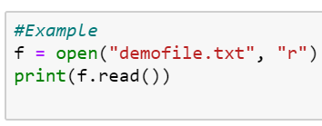
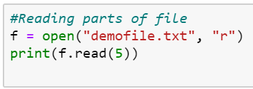
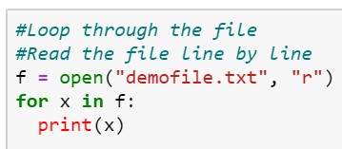
File Handling in Python
The read() function used to read n bytes from the mentioned file
Open
Read
Write / Create
Reading first 5 lines
Reading line by line
Delete

Slide 66
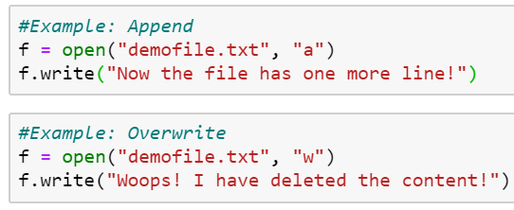
File Handling in Python
To write to an existing file, you must add a parameter to the open() function
Open
"a" - Append – Will append at the end of the file
"w" - Write – Will overwrite the existing content of the file
Read
Write / Create
Delete

Slide 67

File Handling in Python
Creating a new file
Open
Read
"x" - Create - Create a file, returns an error if the file exist
Write / Create
Delete

Slide 68
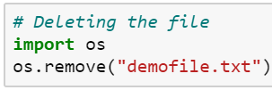
File Handling in Python
Import the OS module
Open
Read
Use the remove() function to delete the mentioned file
Write / Create
Delete

Slide 69
What is Data Manipulation?
<Topic>

Slide 70
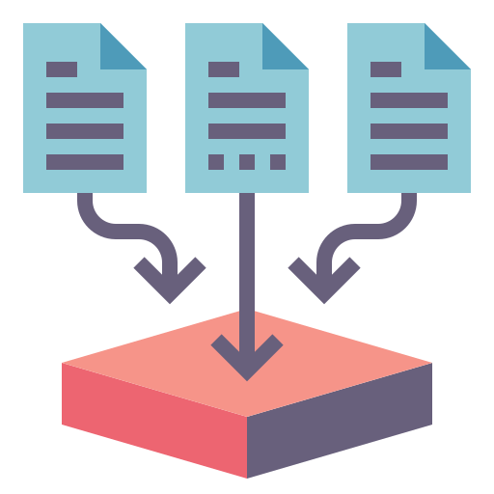

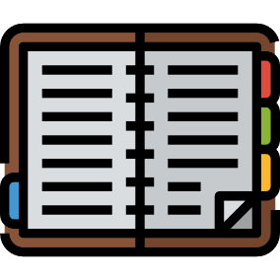
What is Data Manipulation?
Data Manipulation is the process converting data into easily readable information and more organized
Data extraction from multiple sources
Manipulating data using Python
Organized and readable information

Slide 71
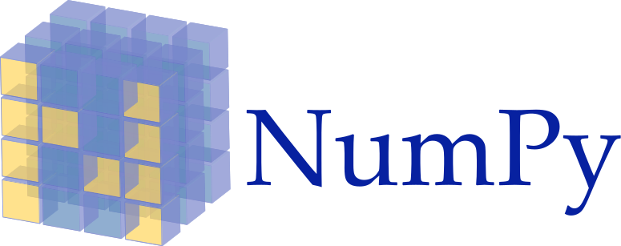
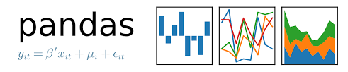


What is Data Manipulation?
These are the popular Python libraries for data manipulation

Slide 72


Why Data Manipulation?
Machine learning and Artificial Intelligence are few areas where data manipulation using Python is required

Slide 73
What is NumPy?
<Topic>

Slide 74
What is NumPy?
The NumPy library is a very popular Python library and the abbreviation is "Numerical Python". The purpose of NumPy library is to do scientific computation and apply them to python applications.

Slide 75
What is NumPy?
What features does NumPy provide?
1
A durable N-Dimensional array
2
Tools to Manipulate and work with the array
3
Perform mathematical and logical operations on the array
4
Powerful pre-defined functions

Slide 76
What is NumPy?
Operations of the NumPy Library
1
Fourier Transform and Shape Manipulation
2
Linear Algebra and Random Number Generation
3
Tools for integrating C/C++
4
Easily integrate with databases

Slide 77
Why NumPy over Lists?
01
NumPy arrays consume lesser memory due to contiguous memory allocation
02
Operations complete quicker in NumPy because of its better runtime behaviour
03
Pre-defined functions for linear algebra operations are available
04
NumPy arrays have fixed types, so there is no type checking in execution which saves time

Slide 78
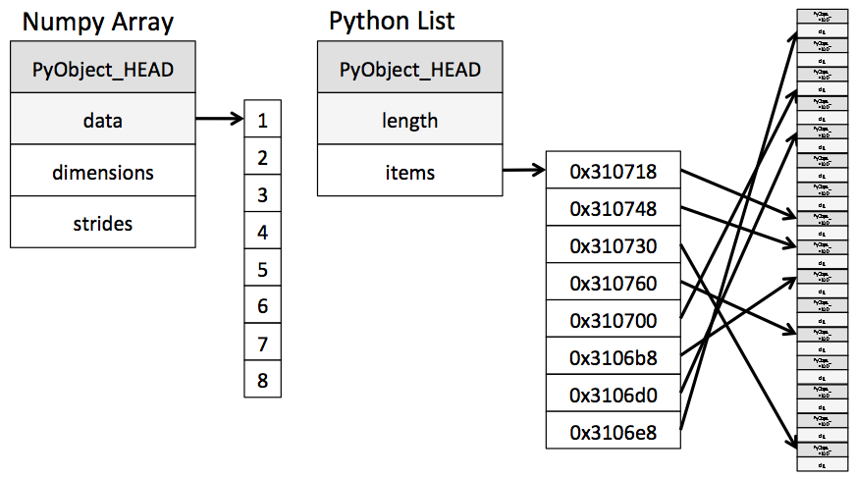



Why NumPy over Lists?
A simple example of why NumPy arrays are better than Python Lists
Pointers
1 element = 4 bytes
1 Object = 14bytes

Slide 79


Thank You

